Slide 1
Linear Anode for Pipeline Rehabilitation
Thirty Years Later
Ted Huck – MATCOR Inc
November 14, 2023

Slide 2
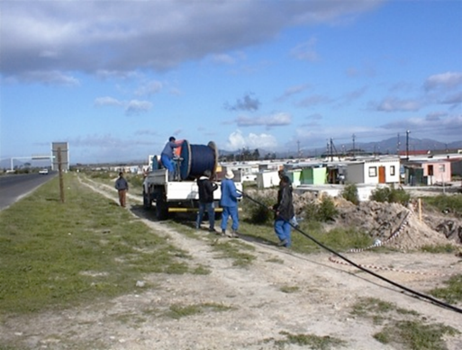
Product History
Mid 1980’s Originated with an innovative polymeric anode cable design where the cable jacket material is also the anode (first generation linear anode)
Mid 1990’s the first Platinum and MMO/Ti products were introduced to address the design flaws inherent with the polymeric anode design (second generation linear anode)
Linear Anode being installed in 2000 in South Africa to protect a water pipeline

Slide 3
Key Features and Benefits
Linear anodes are ideal for current distribution challenges and can be closely coupled to a structure.
Long length can provide great low resistance even in high resistivity soils.
Great for use with Solar Applications due to low wattage requirements
Problem solver for a range of applications.
Can be installed using a range of installation technologies

Slide 4
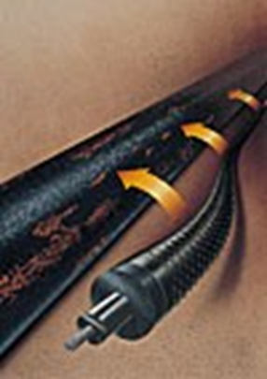
First Generation Linear Anode
Copper core with carbon based polymeric anode extruded on to the copper cable.
Anode centered in fiber woven housing packed with coke backfill
Outer fiber is reinforced with a braiding to add strength and compact the coke around the polymeric cable

Slide 5
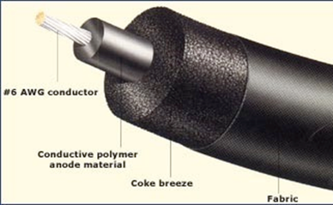
Polymeric (Plastic) Anode
Carbon loaded conductive polymer
Poor anode material not used in any other anode product/application
Susceptible to cracking when operated at or above rated output
Relies heavily on coke backfill to minimize hot spots where localized cracking could occur

Slide 6

Polymeric Anode
Cross sectional view of polymeric anode assembly (excludes fabric and braiding)

Slide 7
Polymeric Anode
Exaggerated cut away depicting the graphite loaded polymeric anode.
The actual graphite particles are much smaller but have been increased for illustration purposes

Slide 8
Polymeric Anode
As the carbon loaded polymer acts as an anode, the carbon is consumed (consumption rate of graphite is approximately 0.9 kgs/A yr) this weakens the polymeric matrix and eventually leads to cracking.
Once there is a crack in the anode the copper will quickly act as the anode and will consume creating a break in the anode.

Slide 9
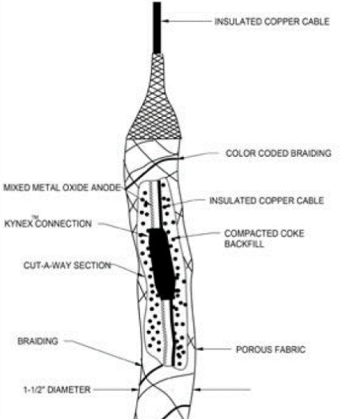
Second Generation Linear Anode
Separates the conductor cable from the anode:
  Provides redundancy with multiple anode to cable connections
  Not limited to 50 mA/m and #6AWG conductor.
  Larger sized conductors can be used with higher output anode wires
  Less susceptible to localized areas of high current discharge
  Spacing of internal connections can vary by manufacturer or be customized to meet customer specific requirements

Slide 10
Value of separating the header cable and anode cable
Polymeric Anode with two anode/conductor breaks
Linear Anode with two anode wire breaks

Slide 11
Linear Anode Applications
AST Tanks
Pipeline Rehabilitation as alternate to Recoat
New Plant Piping Systems
Spot Remediation
Marine Applications
Internal Pipeline Applications

Slide 12
Key Differences 1st and 2nd Generation
Anode Differences
Cable Differences
MMO ideal anode vs less than ideal plastic anode
MMO can be operated at a wide range of outputs, polymeric max is limited to 50 mA/m
Polymeric subject to cracking and premature failure of copper core
MMO is more tolerant to localized current discharge spikes
Polymeric anode has an integral conductor – weak design susceptible to failure and voltage drop
Independent header cable allows for redundancy and reduced voltage drop
Independent header cable can be sized for greater current outputs

Slide 13
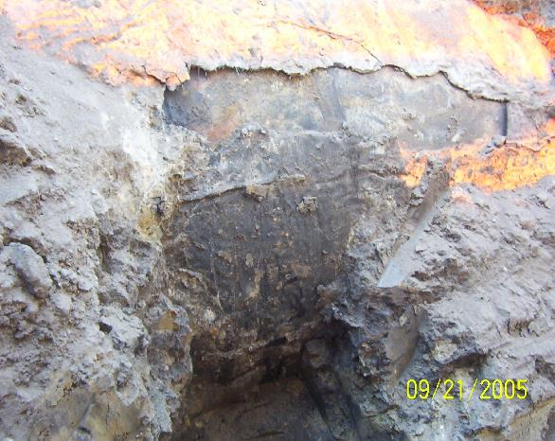
Pipeline Rehabilitation Application
Widely used asphaltic and coal tar enamel (CTE) coatings were the technology of choice for pipelines constructed during the industrial modernization period from the 1950s into the 1970s before being replaced by early FBE coatings.
CTE Coating failure near CP Station

Slide 14
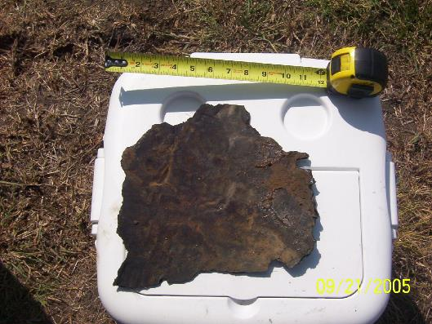
Pipeline Rehabilitation
Linear Anodes can be used for older pipelines instead of recoating
  In older pipelines with coal tar, asphaltic or early epoxy type coatings that are failing in lieu of recoating the pipeline.
  Cannot be used where the coating system shields the pipe (tape coats, PE liners, etc…)

Slide 15
Linear Anode an alternative to recoating for older lines
Designing long length linear anode systems must consider:
Availability of power
Use of header cables to reduce IR drop
Significant changes in resistivity
Existing CP stations
Rectifier
Linear Anode
Pipeline

Slide 16
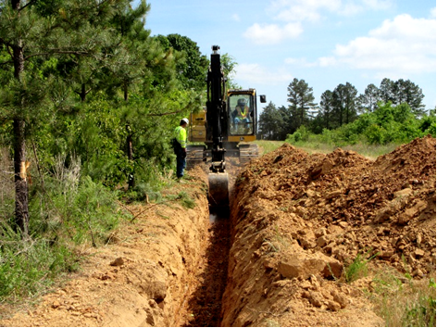
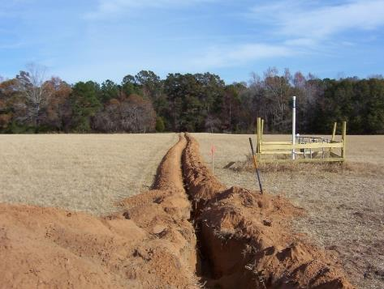
Installation Methodologies
Open Trench installation

Slide 17
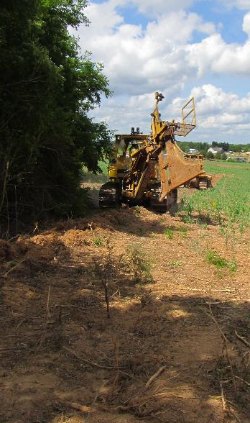
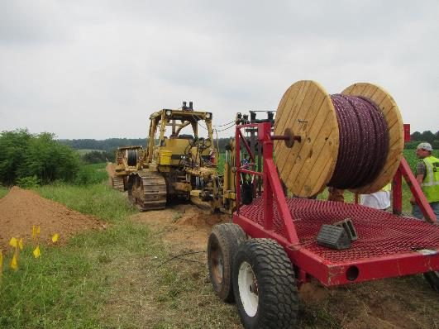
Installation Methodologies
Cable Plow – can install anode and header cable with warning marker tape in one pass.

Slide 18
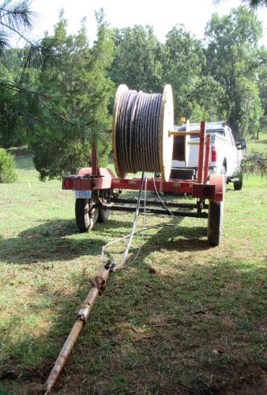
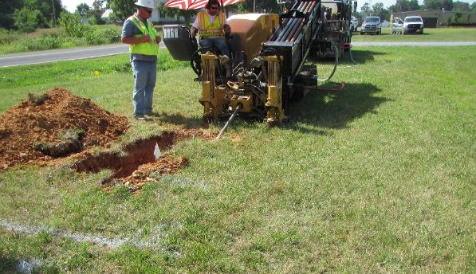
Installation Methodologies
Horizontal Directional Drilling
Low surface impact suitable for crossing under obstructions.

Slide 19
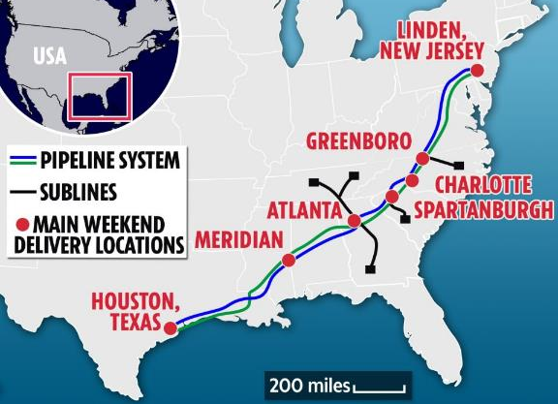
CASE History
Major Pipeline Operator in the United States
Three main lines 8,850 km long carrying refined oil products
Built in the 1960s and suffers from aging coatings and poor CP attenuation
Has successfully installed hundreds of miles of linear anode over a 30+ year period

Slide 20
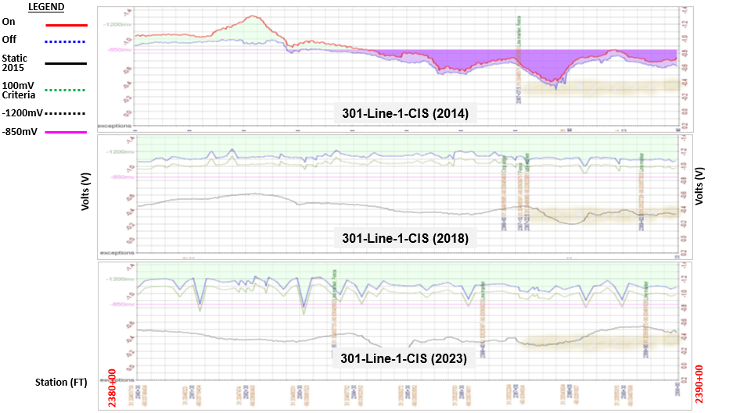
301 Line 2 CIS 2380+00 to 2390+00

Slide 21
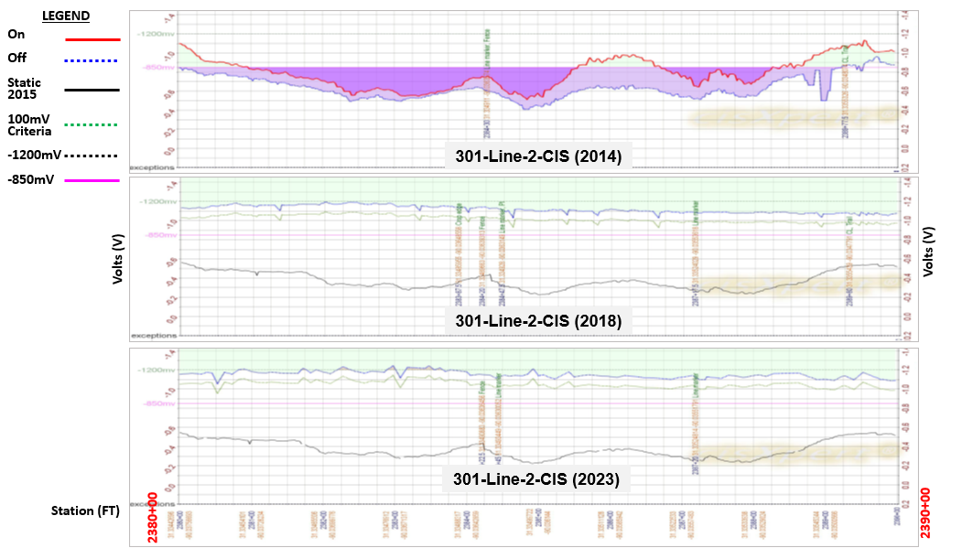
301 Line 2 CIS 2380+00 to 2390+00

Slide 22
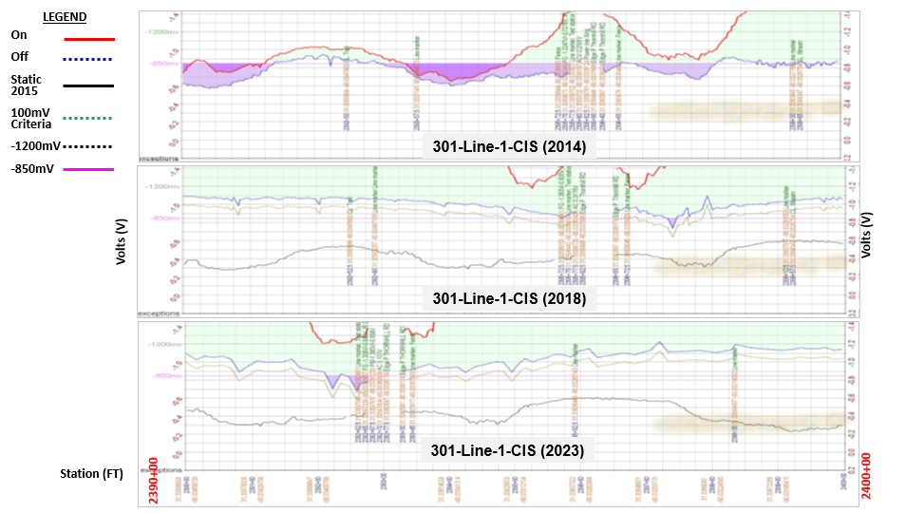
301 Line 1 CIS 2390+00 to 2400+00

Slide 23
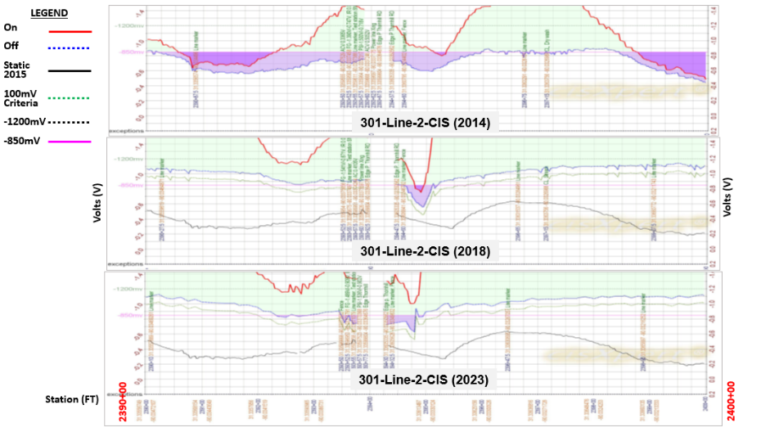
301 Line 2 CIS 2390+00 to 2400+00

Slide 24
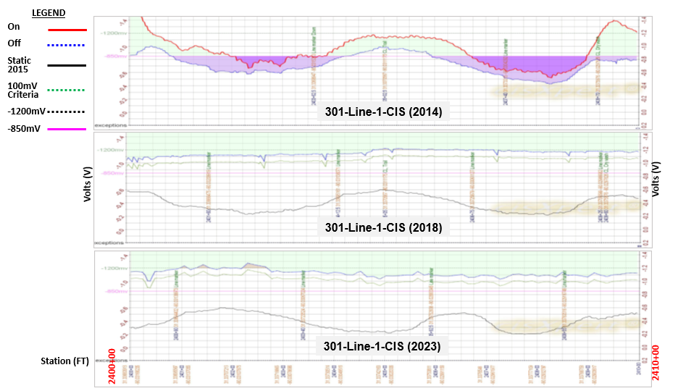
301 Line 1 CIS 2400+00 to 2410+00

Slide 25
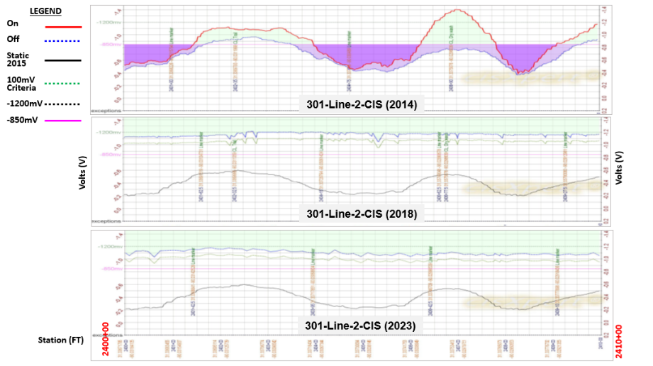
301 Line 2 CIS 2400+00 to 2410+00

Slide 26
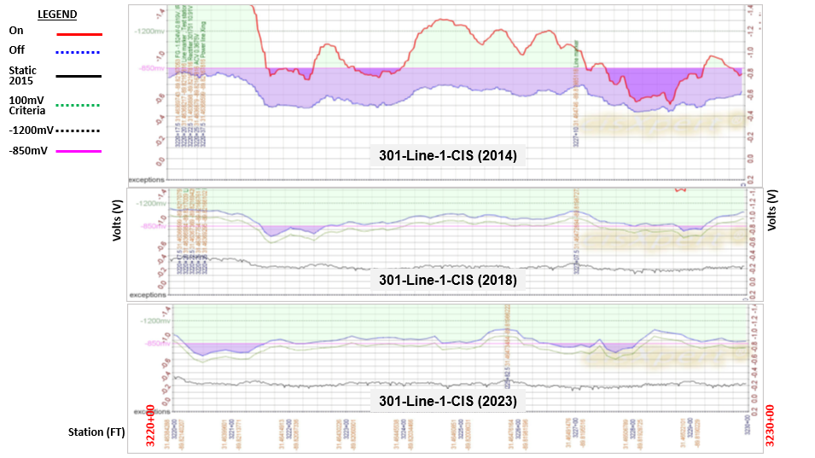
301 Line 1 CIS 3220+00 to 3230+00

Slide 27
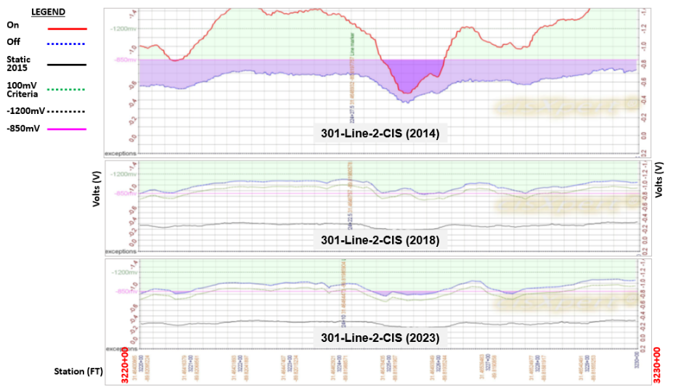
301 Line 2 CIS 3220+00 to 3230+00

Slide 28
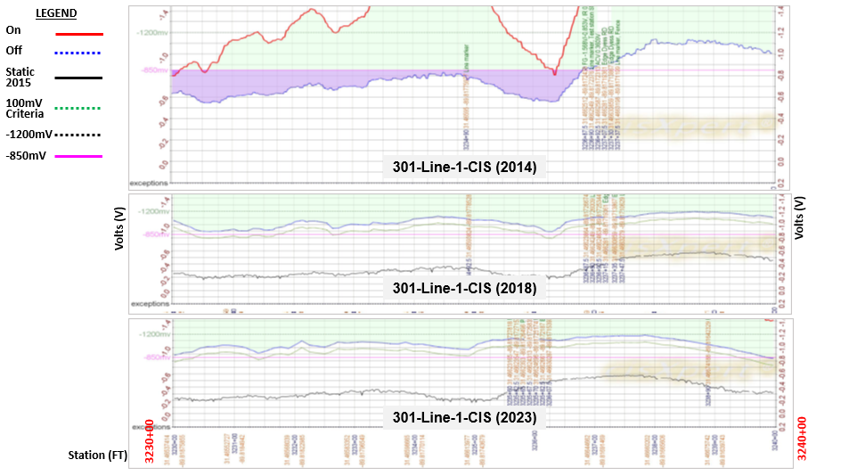
301 Line 1 CIS 3230+00 to 3240+00

Slide 29
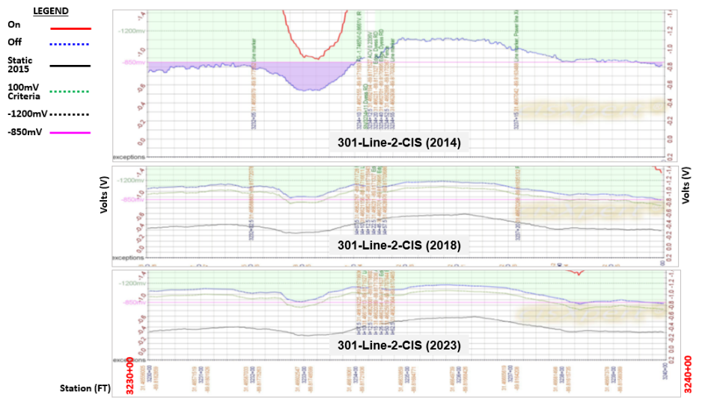
301 Line 2 CIS 3230+00 to 3240+00

Slide 30
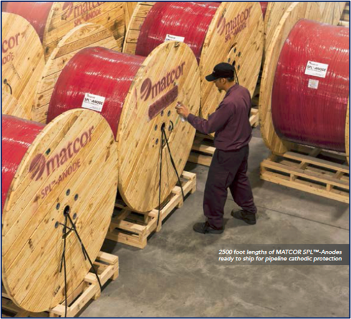

Conclusion
Older pipelines with poor coatings that have exceeded their design life can lead to significant stress for an existing cathodic protection system
Linear Anodes are a cost-effective means of solving a difficult problem with these pipelines
Linear anodes have a demonstrated long service life in this application

